Slide 1
Surge Technical Capabilities Camunda
1

Slide 2

DRIVING AGILITY IN TELECOMMUNICATIONS
Use Cases:
Order and Provisioning Management
Install, Un-install, Upgrade Device software
^{Vendor Management} Onboarding, Contract life cycle
^{Invoice Processing -} ^{Payment Management}
Cost Allocation & Dispute Management
Notes:
Order & Provisioning Management:
Order request and approval
Order placement and order management
Order fulfilment
Order inputs
Inventory inputs (catalogue creation and maintenance)
Invoice Processing & Payment Management
Vendor invoice collection and uploading
Vendor Management
Vendor onboarding
Manage vendor and partner contract life cycle
Wireless plan optimisation
Circuit service optimisation
Cost Allocation & Dispute Management
Budget Allocation and reports
Cost recovery and financial charge back allocation

Slide 3

Challenges
Challenges
Limitations with Zeebe-Kafka Connectors. Workflow Start Event can be mapped with single parameter
Retry – Mechanism was so rigid and static which makes the application to be redeployed for every changes in the retry mechanism parameters
Maintaining the application state in the Event Driven Architecture was the major challenge
Regulating the Alarm Management system was a big challenge as the RULES for generating the alarm keeps changing frequently

Slide 4
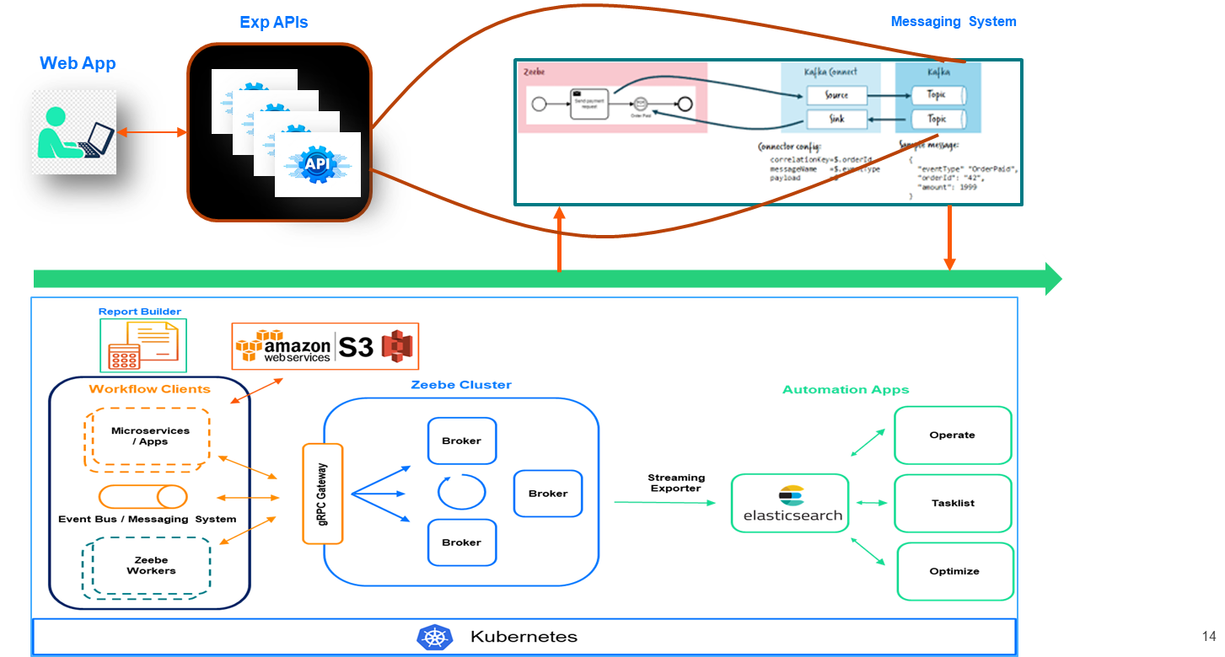
Solution Architecture
Solution
Team gained extensive knowledge on the Zeebe-Kafka connector and developed CUSTOMIZED Zeebe-Kafka connector to meet customer’s business use case
Custom retry mechanism was built and plugged in with NOTIFICATION MANAGEMENT SYSTEM using Camunda integration framework
Camunda Zeebe used as State Machine in Event Driven Microservice Architecture
Camunda – DMN used to build configurable Rule sets which reduced the overhead of multiple deployment cycle

Slide 5
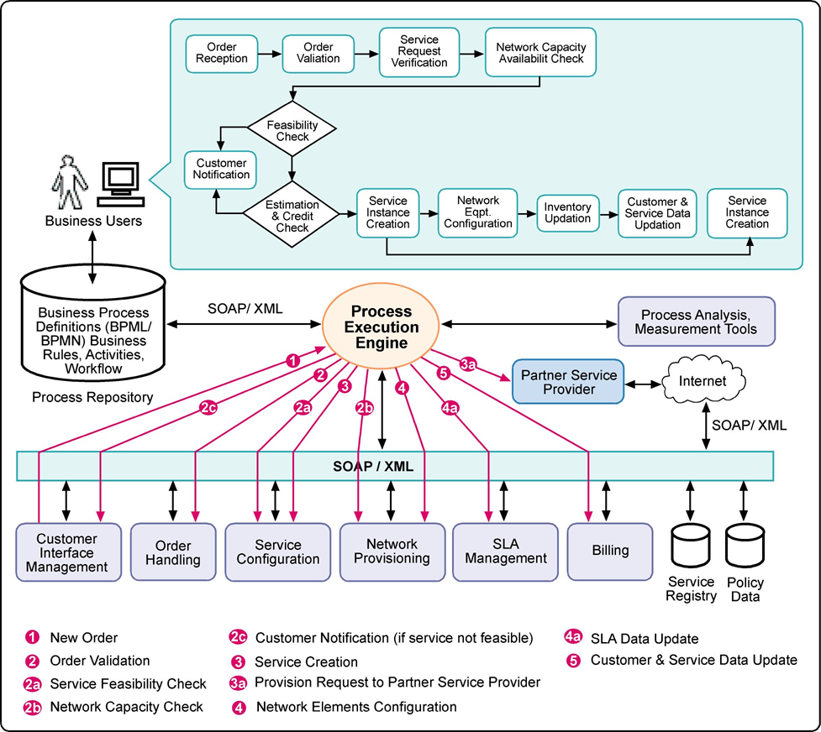
Order and provisioning management
Benefits
Visualize complex logic in one place
Easily align human and automated tasks
Use the same language for business and development, along with native Java support
Easily embed the lightweight Camunda engine in various microservices
Visualize real-time operations with Camunda Operate, seeing at-a-glance the progress of any process
Enable compliance-by-default across global distributed teams, multiple vendors and sensitive data

Slide 6

Leading Construction Equipment Manufacturer
Use Cases:
^{Consignment Delivery Tracking}
^{Defect Resolution Management}
Centralized Report Generation Platform
Machine maintenance & repair tracking
Notes:
Consignment Delivery Tracking
Keep track of consignments in transit as well as your field staff fulfilling deliveries in real-time
Ensure compliance during pick-up and delivery with photographic proof and electronic signature with automated alerts and notifications
Flexibly align operating procedures with your standards and protocols for goods transportation
Coordinate field and back office teams effortlessly to help them provide consistent delivery experiences with the ability to track pit stops and trip incentives
Collaborate with customers and provide them with real-time updates on consignment delivery
Defect Resolution Management
Obtain a bird’s eye view of all defects and ongoing complaints
Define custom procedural workflow in handling various types of complaints and ensure compliance
Enhance accountability and make sure remediations or corrective actions are followed through in detail with proof of corrective actions taken
Identify defects and provide references of defects with photographs and maintain a centralised system of investigation notes
Live-track field teams while they conduct investigations at customer locations
Machine maintenance & repair tracking
Manage preventive maintenance of machines by scheduling and monitoring periodic maintenance activities across facilities in real-time
Ensure compliance with organisational maintenance standards by adhering to SOPs with detailed checklists and photographic proof of completion
Track and manage breakdown workflows for immediate resolution and subsequently drive root cause analysis, resulting in improved preventive maintenance
Improve accountability with centralised governance of maintenance activities at all levels i.e. local, regional, and corporate
Live-track roaming engineers providing specialist maintenance and repair services across multiple facilities and locations

Slide 7

Challenges
Challenges
Gather Data from Multiple applications
Complex custom logic to process the data
Configurable RULE engine to bring more agility into in the workflow system
Business and IT teams struggle to communicate and collaborate to publish new Reports.

Slide 8
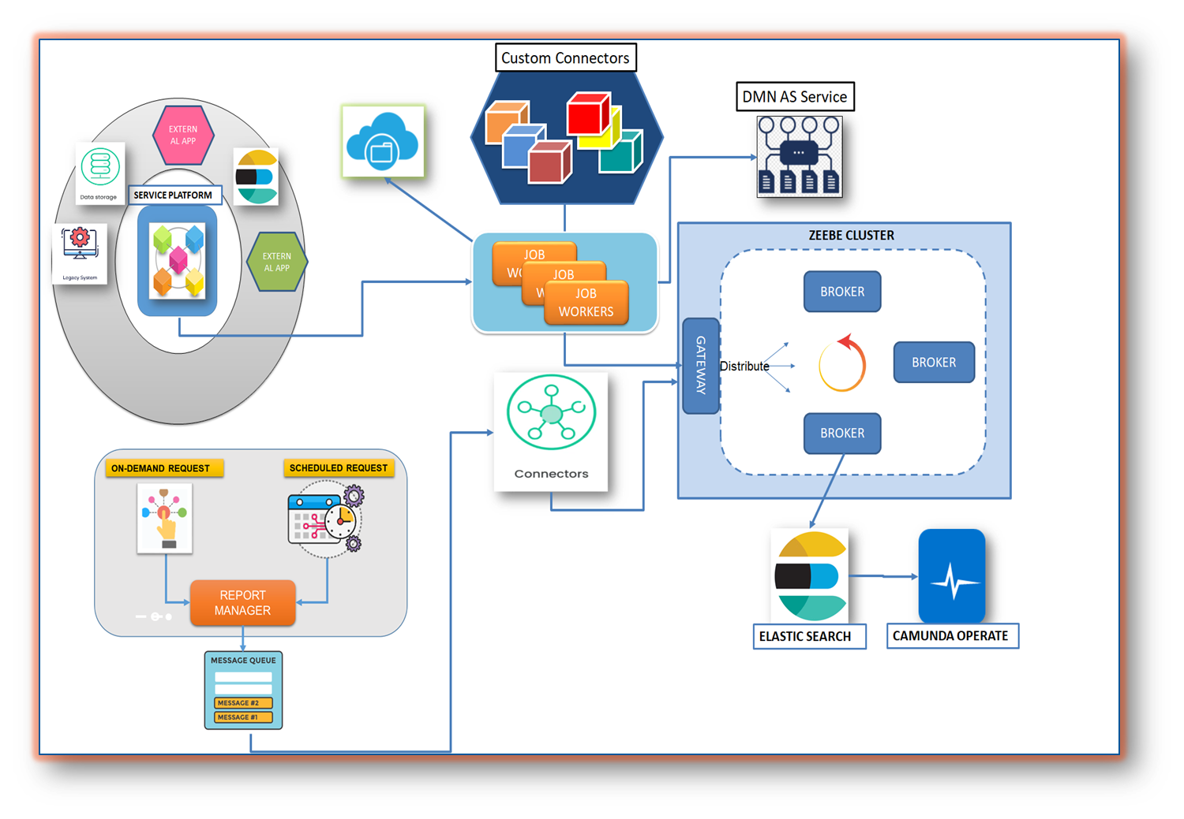
Solution Architecture
Solution
Existing solution was replaced by Camunda Process Orchestrator for collecting and aggregating data from multiple sources
Custom Connectors – 40% of logic has been moved as reusable components (Connectors) which can be used across the reports & developers has the flexibility to drag & drop the connectors while designing the process
Customized SQS Inbound Connector was build to support SQS Batch incoming messages with camunda engine

Slide 9
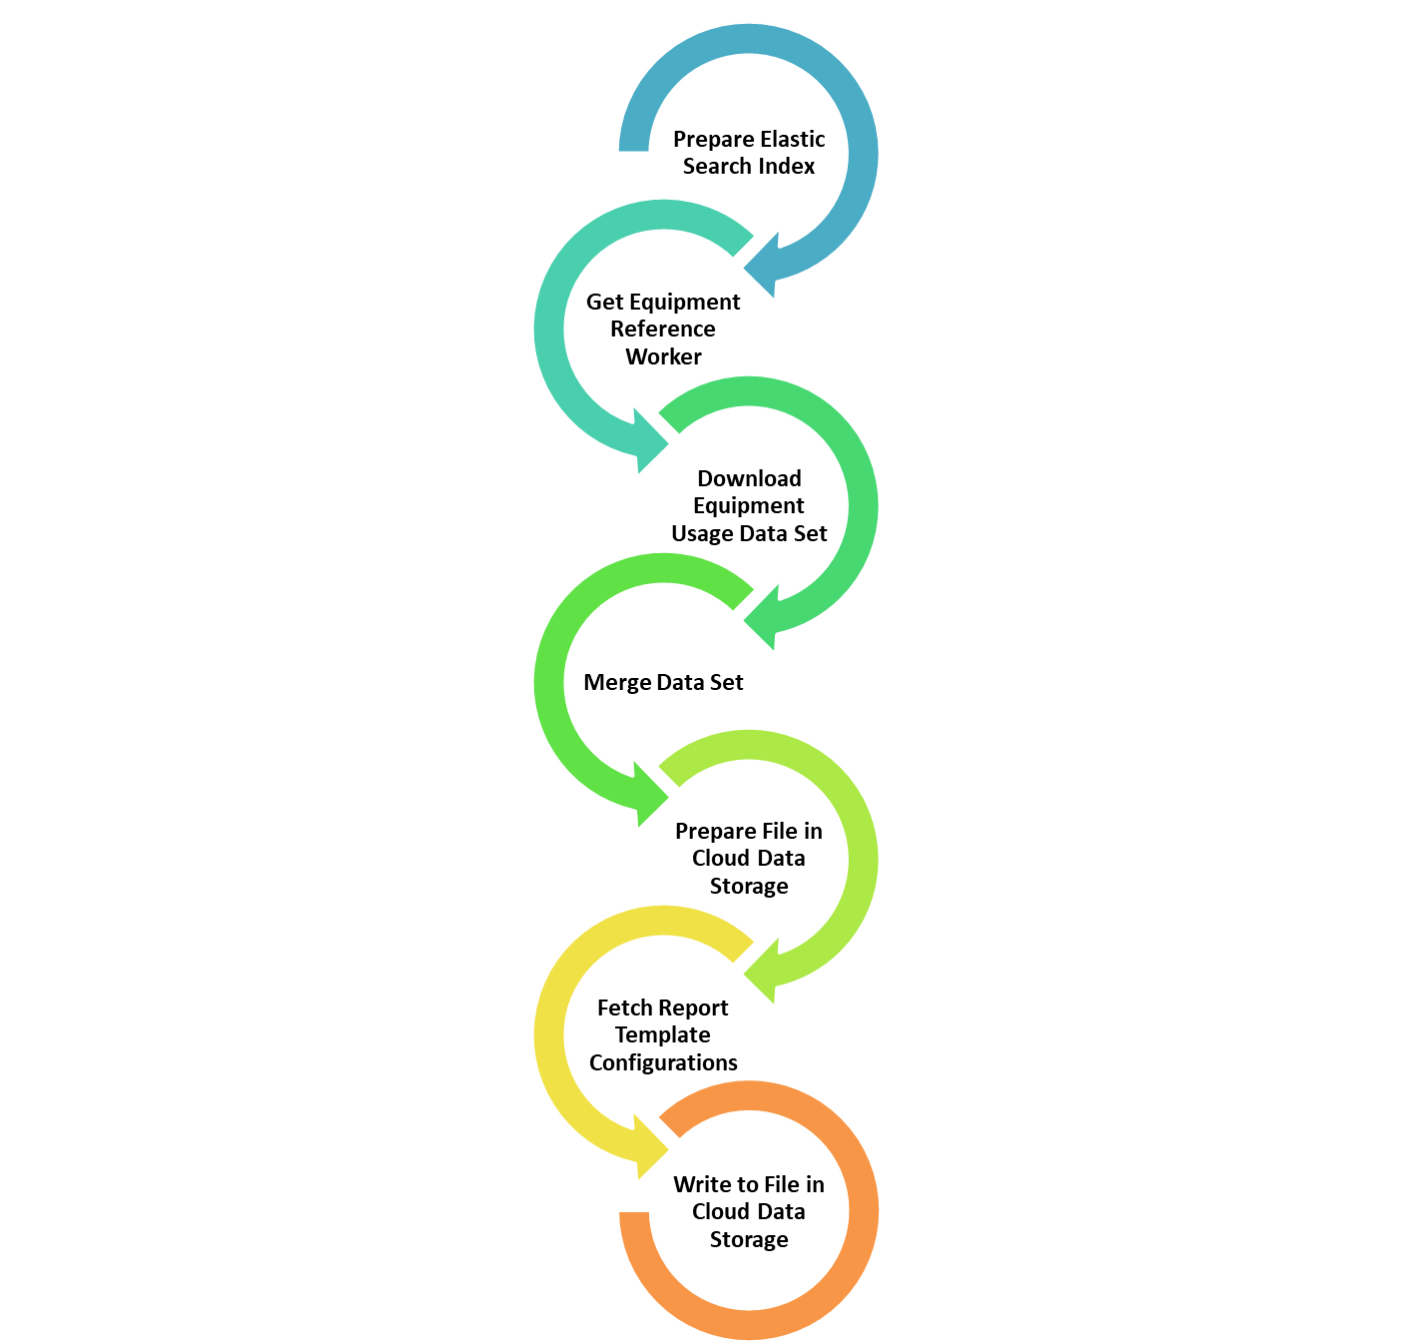
Equipment Management Report
Solutions
BUSINESS RULE AS SERVICE- Developed Custom Component BRAS
10% of the static business key attributes are moved into configurable business rules (DMN) & Business users has the flexibility to update the business rules
60% of Total effort has been reduced in development effort by using Custom Connectors and BRAS

Slide 10

Financial & Wealth Management
Use Cases:
^{Personal Banking} Services – Business deposit accounts, Cash Management Services
CreditPlus - A central asset management tool that combines your securities, checking and Visa Gold Card transactions into one single account
ClientLink – Online Access - Customer can access their accounts 24/7. It provides convenient online account access anytime you want it
^{Financial Advisor Onboarding}

Slide 11

Challenges
Challenges
Intuitive UI forms requested for orchestrating the user activities as Camunda forms meets basic functionalities
^{Data Aggregation} leads to carry out huge volume of data across the process tasks
Camunda 8 has limitation over no OUT OF BOX AUTHENTICATION and KEYCLOAK made mandatory

Slide 12
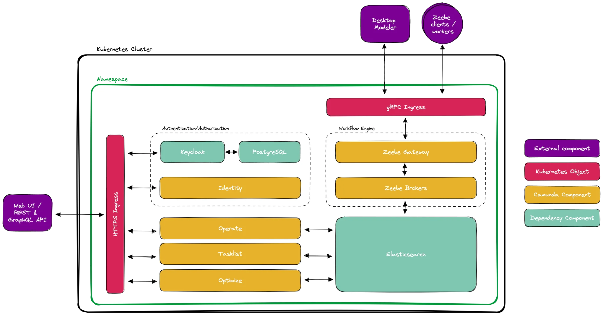
Solution Architecture
Solutions
Built customized Task list application to address Human Task Orchestration with Rich UI using ReactJs and Tasklist APIs
Our solution over comes the process instance max size limit 4 mb by enabling the intercepting temporary storage (Elastic)
Customer had a different identity provider in use, we forced to set up Keycloak as an identity provider so that you are forced to run Keycloak in addition to your existing identity provider for Camunda 8

Slide 13
Financial & Wealth Management
Advantages:
Process Orchestration made easy to gather data from multiple applications
Re-Usable Components via Custom Connectors reduced 60% development time
Rule Engine (DMN) As a Service help the business to configure the Report and Report Attributes
Service Orchestration has helped to generate the huge volumes of Report Data in quick turn around time (< 1 min)

Slide 14

Leading Global Investment Banking
Use Cases:
Process Orchestration made easy to gather data from multiple applications
Re-Usable Components via Custom Connectors reduced 60% development time
Rule Engine (DMN) As a Service help the business to configure the Report and Report Attributes
Service Orchestration has helped to generate the huge volumes of Report Data in quick turn around time (< 1 min)

Slide 15
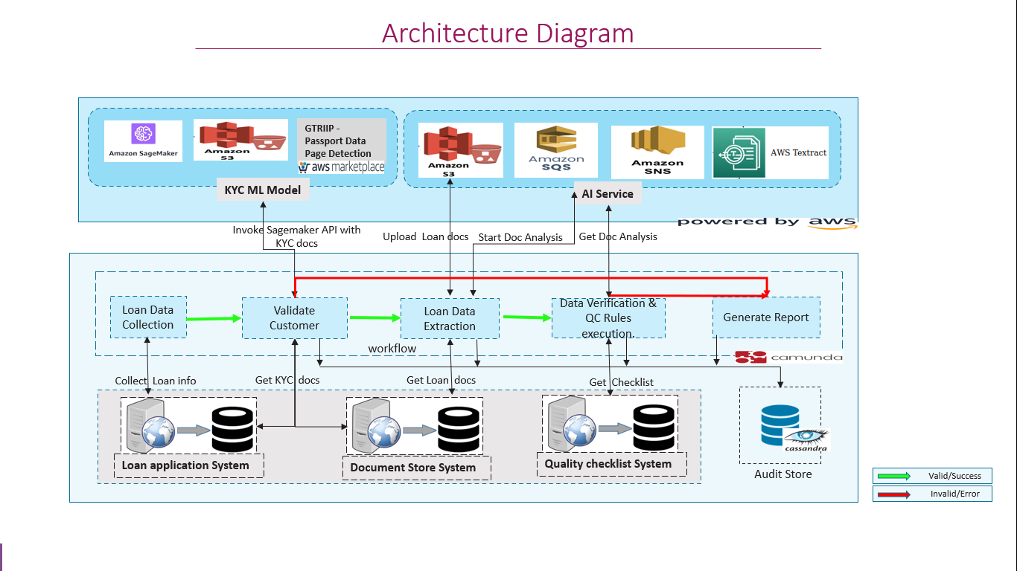
Solution Architecture – Loan Processing
Challenges
Process Orchestration made easy to gather data from multiple applications
Re-Usable Components via Custom Connectors reduced 60% development time
Rule Engine (DMN) As a Service help the business to configure the Report and Report Attributes
Service Orchestration has helped to generate the huge volumes of Report Data in quick turn around time (< 1 min)

Slide 16


Slide 17

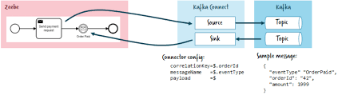

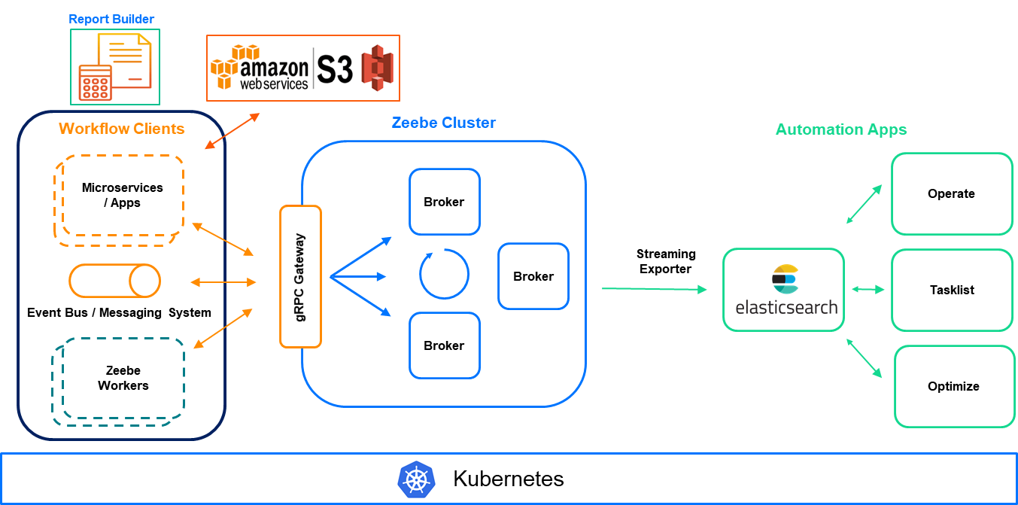
Exp APIs
Messaging System
Web App

Slide 18




Report Builder
Workflow Clients
Zeebe Cluster
Automation Apps
Microservices / Apps
Operate
Broker
Broker
Broker
Streaming Exporter
gRPC Gateway
Broker
Tasklist
gRPC Gateway
Event Bus / Messaging System
Broker
Broker
Zeebe Workers
Optimize
Zeebe Workers
Kubernetes

Slide 20
